Slide 1
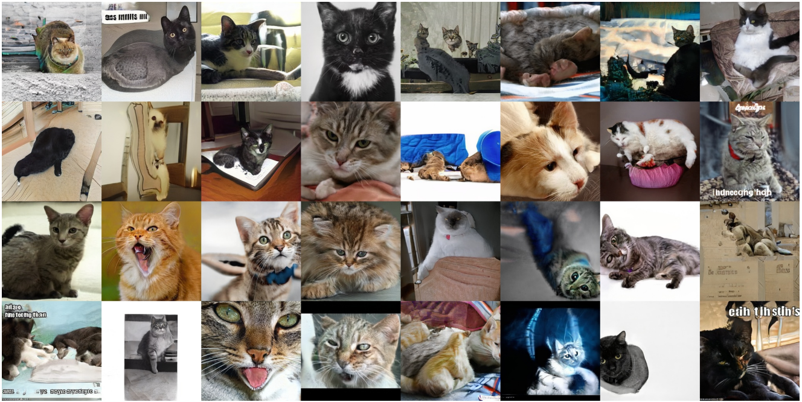
1
Perceptual Loss, GANs (part I)
Jun-Yan Zhu 16-726 Learning-based Image Synthesis, Spring 2021
many slides from Phillip Isola, Richard Zhang, Alyosha Efros
© Karras et al., StyleGAN2, CVPR 2020

Slide 2
HW1 (hints)

Slide 3
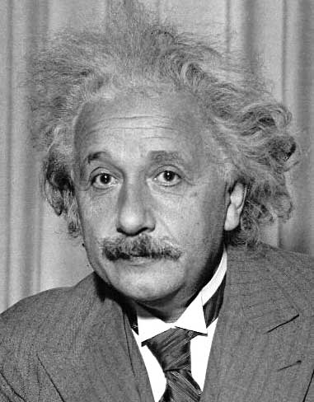
Template matching
Goal: find in image
Main challenge: What is a good similarity or distance measure between two patches?
Correlation
Zero-mean correlation
Sum Square Difference
Normalized Cross Correlation
Side by Derek Hoiem
Notes:
3

Slide 4
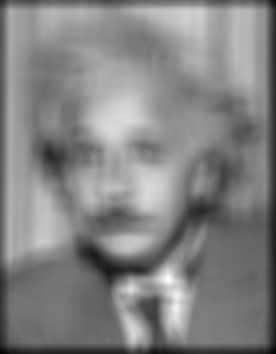
Matching with filters
Goal: find in image
Method 0: filter the image with eye patch
f = image
g = filter
What went wrong?
Input
Filtered Image
Side by Derek Hoiem
Notes:
4

Slide 5
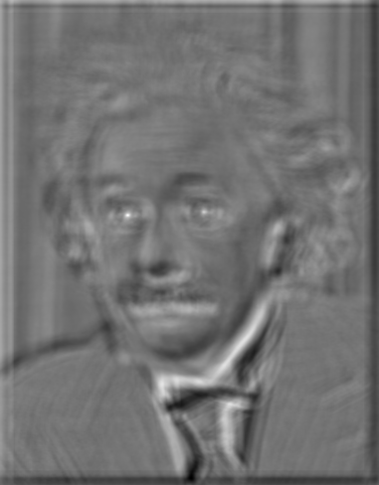
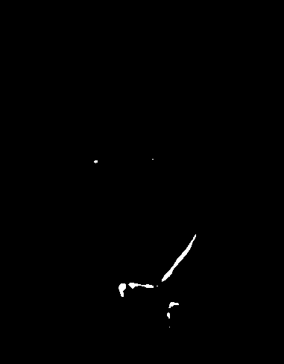
Matching with filters
Goal: find in image
Method 1: filter the image with zero-mean eye
f = image
g = filter
mean of f
True detections
False detections
Input
Filtered Image (scaled)
Thresholded Image
Notes:
5

Slide 6
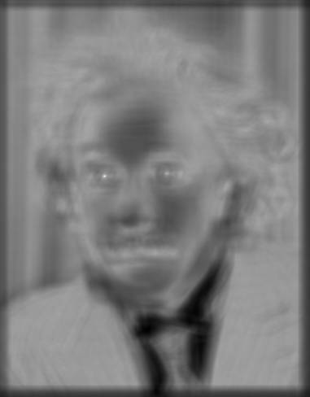
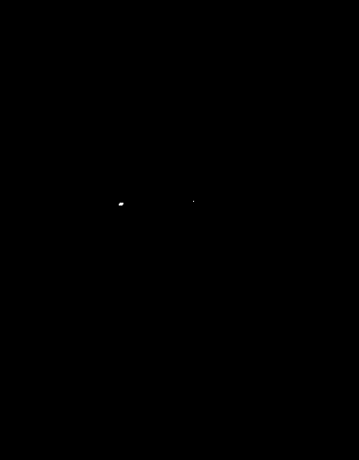
Matching with filters
Goal: find in image
Method 2: SSD (Sum Square Difference)
f = image
g = filter
True detections
Input
1- sqrt(SSD)
Thresholded Image
Notes:
6

Slide 7
Matching with filters
Can SSD be implemented with linear filters?
f = image
g = filter
Side by Derek Hoiem

Slide 8
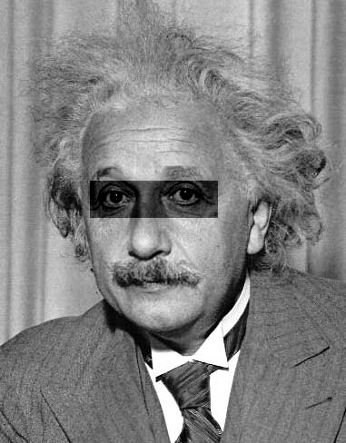
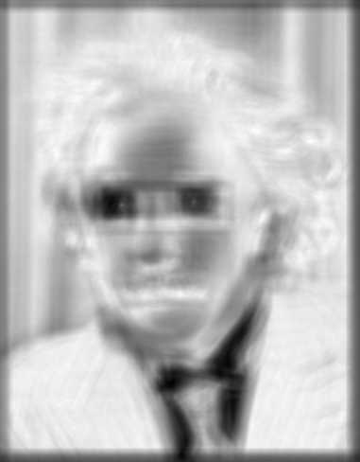
Matching with filters
What’s the potential downside of SSD?
Goal: find in image
Method 2: SSD (Sum Square Difference)
f = image
g = filter
Input
1- sqrt(SSD)
Side by Derek Hoiem
Notes:
8

Slide 9
Matching with filters
Goal: find in image
Method 2: Normalized Cross-Correlation
f = image
g = filter
mean template
mean image patch
Side by Derek Hoiem
Notes:
9

Slide 10
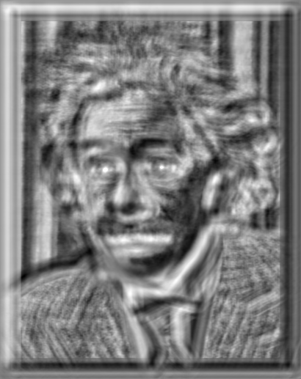

Matching with filters
Goal: find in image
Method 2: Normalized Cross-Correlation
True detections
Input
Normalized X-Correlation
Thresholded Image
Notes:
10

Slide 11
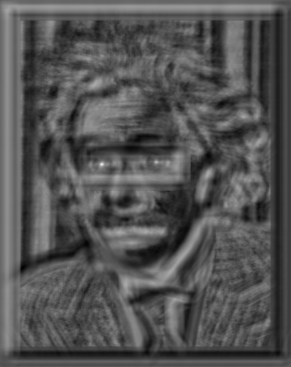
Matching with filters
Goal: find in image
Method 2: Normalized Cross-Correlation
True detections
Input
Normalized X-Correlation
Thresholded Image
Notes:
11

Slide 12
Q: What is the best method to use?
Answer: Depends
Zero-mean filter: fastest but not a great matcher
SSD: next fastest, sensitive to overall intensity
Normalized cross-correlation: slowest, invariant to local average intensity and contrast
Side by Derek Hoiem

Slide 13
Review (CNN for Image Synthesis)

Slide 14
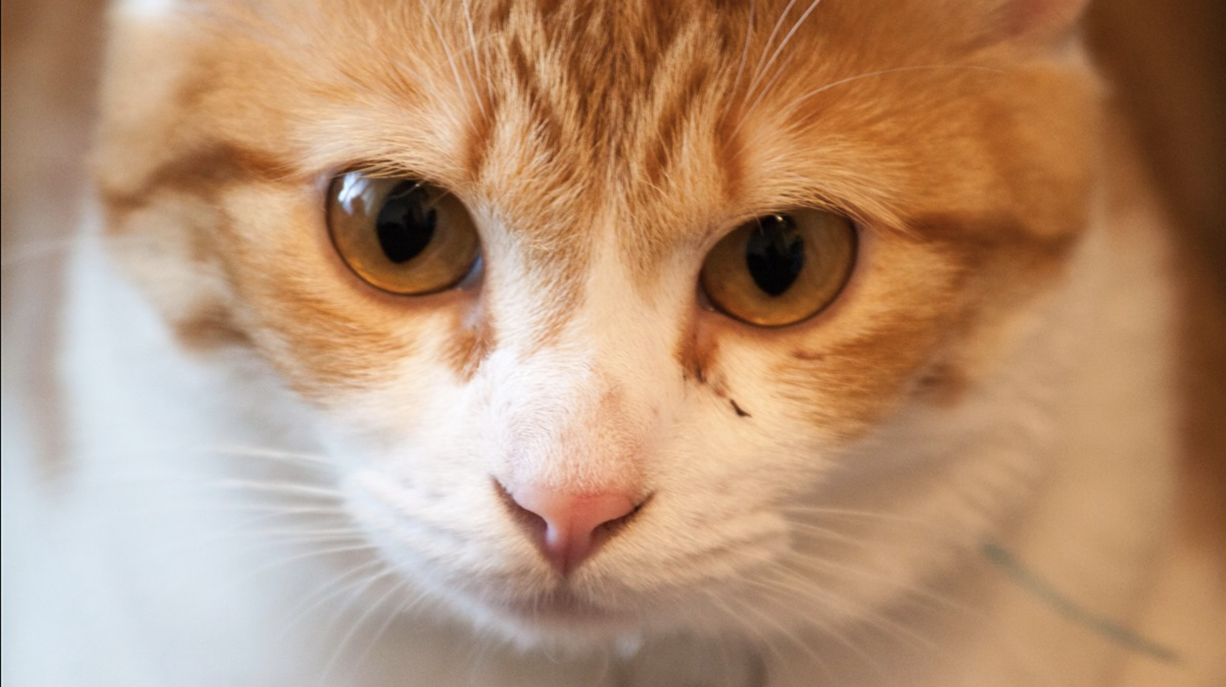
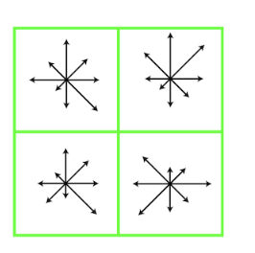
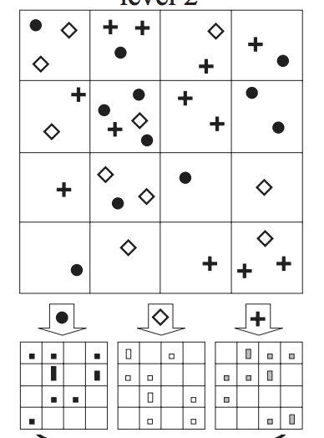
Computer Vision before 2012
Cat
Features
Clustering
Pooling
Classification

Slide 15
Computer Vision Now
Cat
Features
Clustering
Pooling
Classification
Cat
Deep Net
[LeCun et al, 1998], [Krizhevsky et al, 2012]

Slide 16

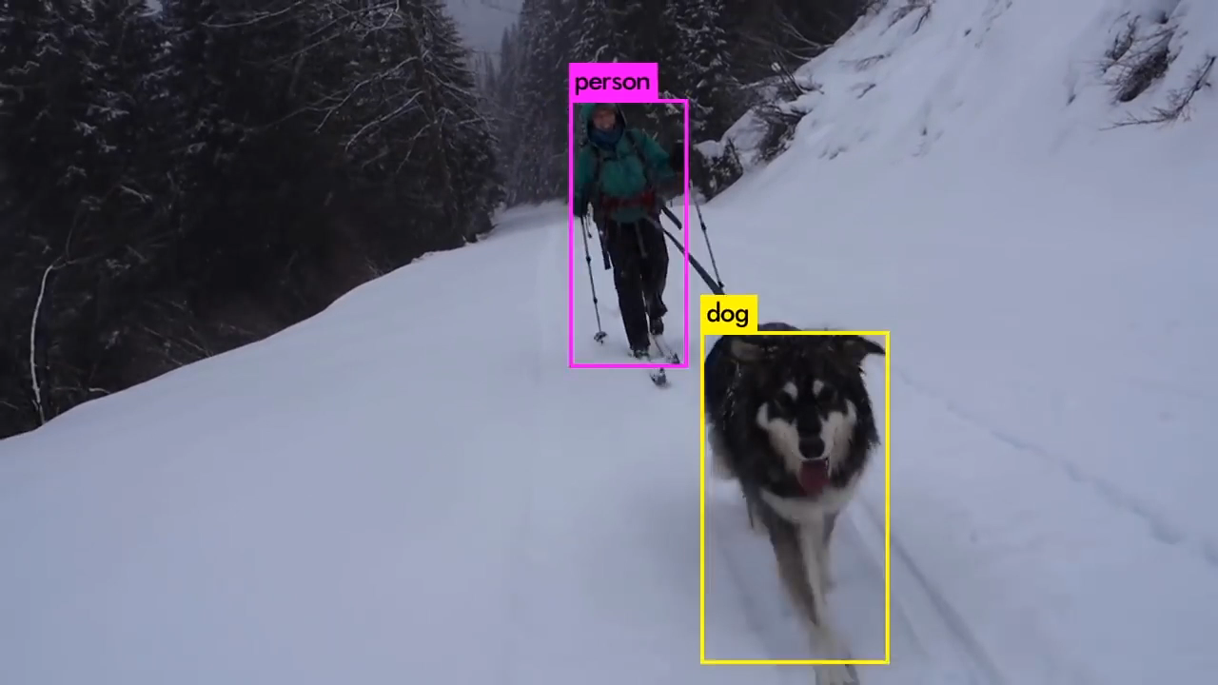
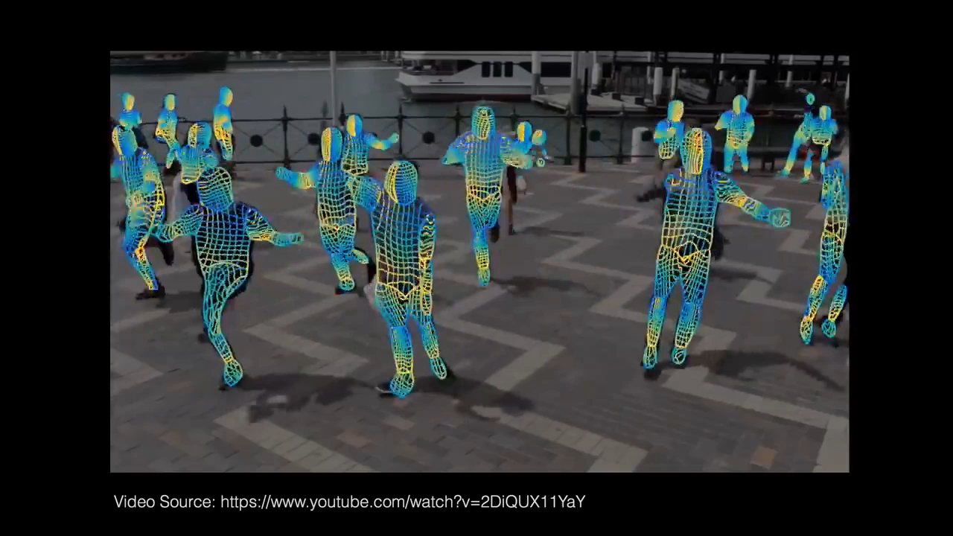
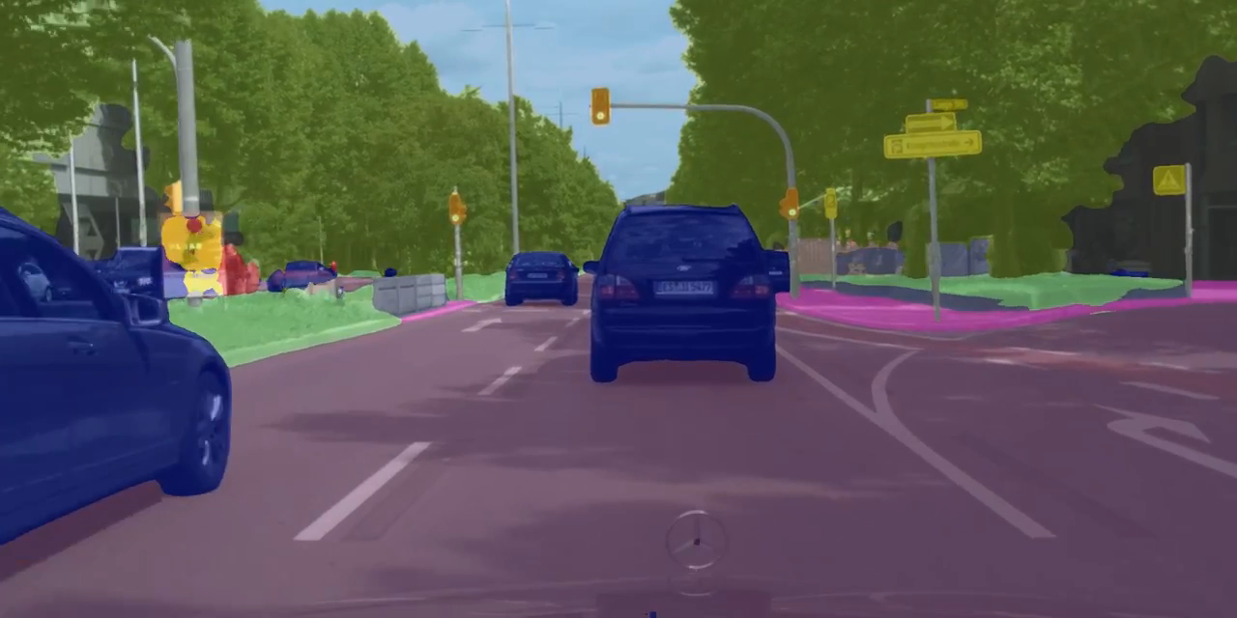
Deep Learning for Computer Vision
Deep Net
[Deng et al. 2009]
Top 5 accuracy on ImageNet benchmark
[Redmon et al., 2018]
[Güler et al., 2018]
[Zhao et al., 2017]
Object detection
Human understanding
Autonomous driving

Slide 17
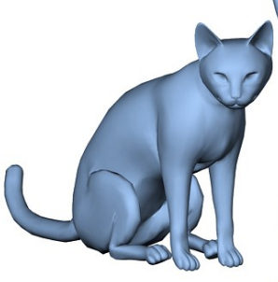
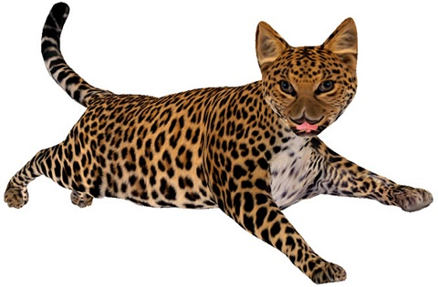
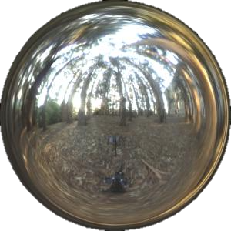
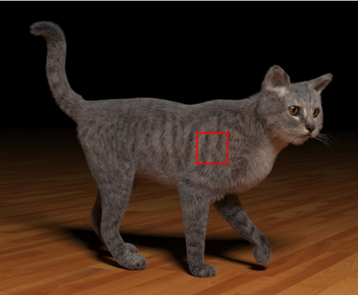
Can Deep Learning Help Graphics?
Cat
Modeling
Texturing
Lighting
Rendering

Slide 18
Can Deep Learning Help Graphics?
Cat
Modeling
Texturing
Lighting
Rendering
Did not work
Cat
Deep Net

Slide 19

Generating images is hard!
Cat
Modeling
Texturing
Lighting
Rendering
8
Deep Net
28x28 pixels

Slide 20
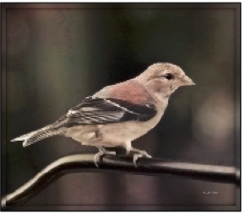
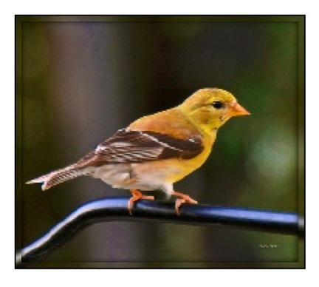
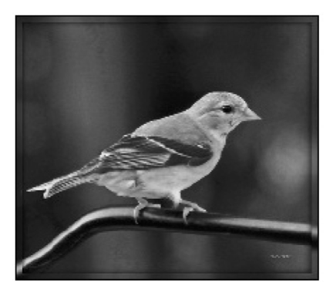
Simple L2 regression doesn’t work ☹
Input
Output
Ground truth

Slide 21
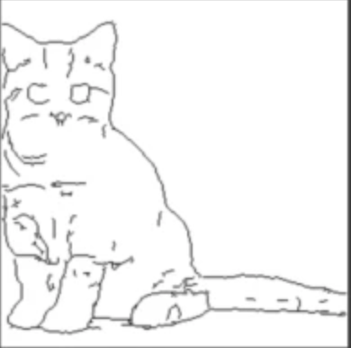
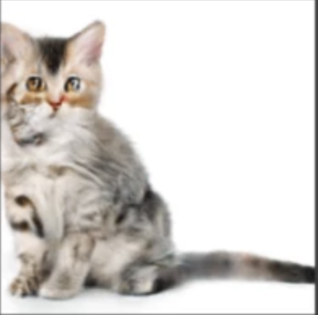
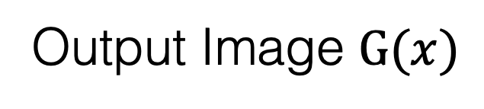
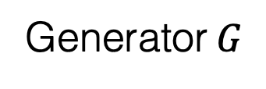
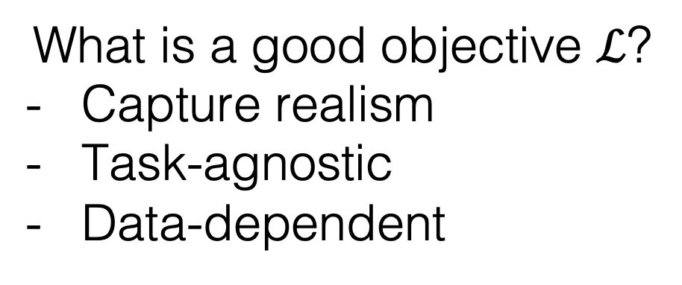
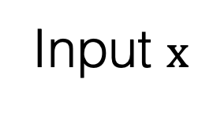
Loss functions for Image Synthesis
Generator$G$
Input $x$
Learnable rendering
Output Image $G(x)$
What is a good objective $ℒ$?
Capture realism
Task-agnostic
Data-dependent
Problem Statement
Loss function
Generator
Input
Output image

Slide 22
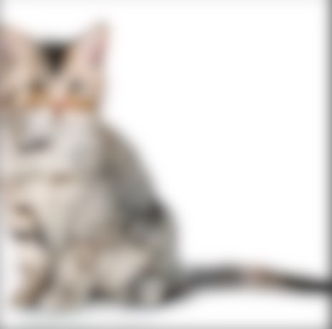
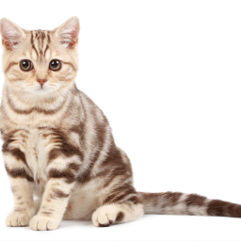

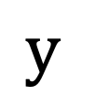
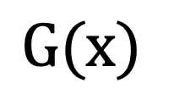
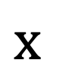


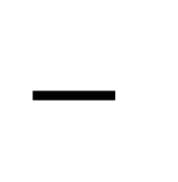
Designing Loss Functions
$$x$$
$$G(x)$$
$$y$$
$$|$$
$$−$$
$$|$$
$$G$$
Input
Generator
Predicted output
GT output
L2 regression

Slide 23
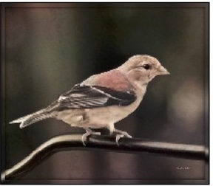
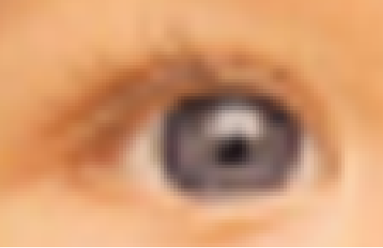
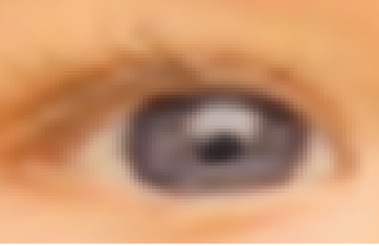
Designing Loss Functions
Image colorization
L2 regression
Super-resolution
L2 regression

Slide 24
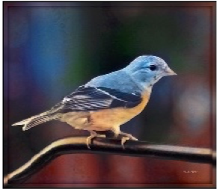
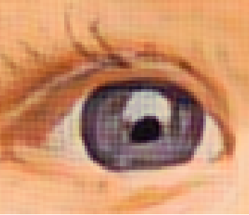
Designing Loss Functions
Image colorization
Classification Loss:
Cross entropy objective, with colorfulness term
[Zhang et al. 2016]
Super-resolution
Feature/Perceptual loss
Deep feature covariance matching objective
[Gatys et al., 2016], [Johnson et al. 2016]
[Dosovitskiy and Brox. 2016]

Slide 25
“Perceptual Loss”
Gatys et al. In CVPR, 2016.
Johnson et al. In ECCV, 2016.
Dosovitskiy and Brox. In NIPS, 2016.
Chen and Koltun. In ICCV, 2017.

Slide 26
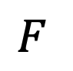
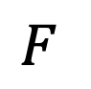
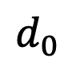
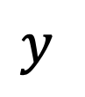
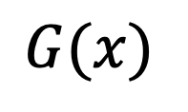
CNNs as a Perceptual Metric
Normalize, Subtract
L₂ norm,
Spatial average
Avg
$$F$$
$$F$$
$$d_{0}$$
$$G(x)$$
$$y$$
(1) How well do “perceptual losses” describe perception?
(2) Does it have to be the VGG network pre-trained on classification?
c.f. Gatys et al. CVPR 2016. Johnson et al. ECCV 2016. Dosovitskiy and Brox. NIPS 2016.

Slide 27
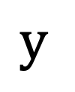

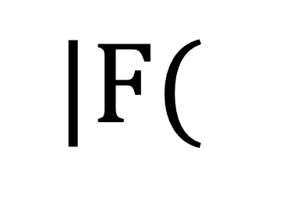
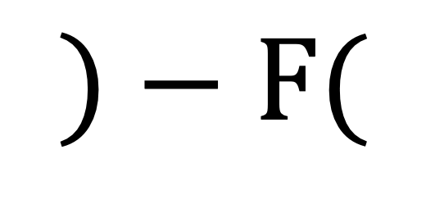
CNNs as a Perceptual Metric
$$x$$
$$G(x)$$
$$y$$
$$|F($$
$$)−F($$
$$)|$$
$$G$$
Input
Generator
Predicted output
GT output
F is a deep network (e.g., ImageNet classifier)
Perceptual Loss
weight
(i)-th layer
The number of elements in the (i)-th layer

Slide 28
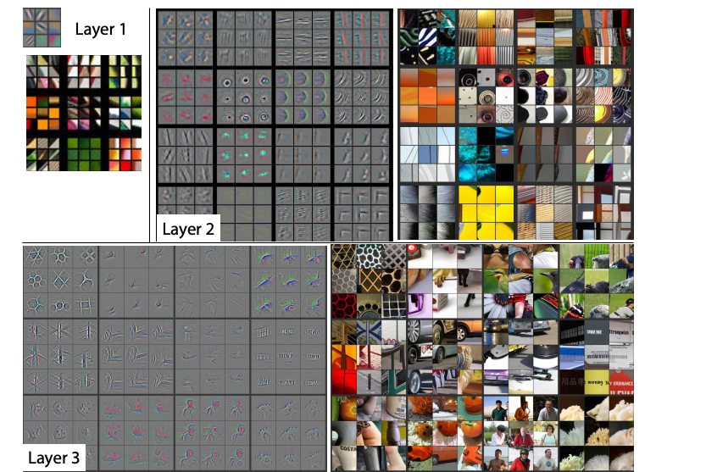
What has a CNN Learned?
Zeiler and Fergus. In ECCV, 2014.

Slide 29


What has a CNN Learned?
Zeiler and Fergus. In ECCV, 2014.

Slide 30
CNNs as a Perceptual Metric
Normalize, Subtract
L₂ norm,
Spatial average
Avg
$$F$$
$$F$$
$$d_{0}$$
$$G(x)$$
$$y$$
Perceptual Loss
weight
(i)-th layer
The number of elements in the (i)-th layer

Slide 31
How Different are these Patches?
D (
)
,
Zhang, Isola, Efros, Shechtman, Wang.
The Unreasonable Effectiveness of Deep Features as a Perceptual Metric. In CVPR, 2018.

Slide 32
Which patch is more similar to the middle?
< Type 1 >
Humans
< Type 2 >
L2/PSNR
SSIM/FSIMc
Deep Networks?

Slide 33
% agreement with
human judges
82.6
Networks perform strongly across supervisory signals and architectures
Human
Bigger/Deeper ≠ Better
Low-level
AlexNet (Random)
78.0
AlexNet (Unsupervised)
Fitting some data
is important
AlexNet (Self-supervised)
76.8
Nets (Supervised - Imagenet classification)
75.7
74.8
70.6
69.7
70.0
68.9
L2
SSIM
K-Means
Squeeze
AlexNet
VGG
FSIMc
Random
Human
VGG (“perceptual loss”)
correlates well

Slide 34


Generated images
Universal loss?
…
…

Slide 35



Learning with Human Perception
Generated images
Human Annotation
…
…
Real vs. Fake
Real photos
…
[Zhu et al. 2014]

Slide 36

Generated images
Generative Adversarial Network
(GANs)
…
…
Classifier
Real vs. Fake
Real photos
[Goodfellow, Pouget-Abadie, Mirza, Xu, Warde-Farley, Ozair, Courville, Bengio 2014]
…

Slide 37







Image synthesis from “noise”
Generator

Slide 38

Image synthesis from “noise”
Generator

Slide 39

Image synthesis from “noise”
Generator

Slide 40









Learning a generative model
latent variables
[figs modified from: http://introtodeeplearning.com/materials/2019_6S191_L4.pdf]

Slide 41




Learning a density model
Normalized distribution
(some models output unormalized energy functions)
[figs modified from: http://introtodeeplearning.com/materials/2019_6S191_L4.pdf]

Slide 42






Case study #1: Fitting a Gaussian to data
Max likelihood objective
Considering only Gaussian fits
Closed form optimum:
fig from [Goodfellow, 2016]

Slide 43

Case study #1: Fitting a Gaussian to data
“max likelihood”

Slide 44
Case study #2: learning a deep generative model
max likelihood
/distribution matching
Deep net
SGD

Slide 45
Case study #2: learning a deep generative model
max likelihood
/distribution matching
Deep net
SGD
Models that provide a sampler but no density are called implicit generative models

Slide 46


Deep generative models are distribution transformers
Prior distribution
Target distribution

Slide 47



Deep generative models are distribution transformers
Gaussian noise
Synthesized image

Slide 48
Deep generative models are distribution transformers
Gaussian noise
Synthesized image

Slide 49
Generative Adversarial Networks (GANs)
Gaussian noise
Synthesized image

Slide 50



$$z$$
$$G(z)$$
$$G$$
Random code
Generator
fake image
© aleju/cat-generator
[Goodfellow et al. 2014]

Slide 51


$$z$$
$$G(z)$$
$$G$$
$$D$$
Real (1) or
fake (0)?
Random code
Generator
Discriminator
fake image
A two-player game:
$G$ tries to generate fake images that can fool $D.$
$D$ tries to detect fake images.
[Goodfellow et al. 2014]

Slide 52
$$z$$
$$G(z)$$
$$G$$
$$D$$
fake (0.1)
Random code
Generator
Discriminator
fake image
Learning objective (GANs)
[Goodfellow et al. 2014]

Slide 53


$$z$$
$$G(z)$$
$$G$$
$$D$$
fake (0.1)
Random code
Generator
Discriminator
fake image
$$x$$
$$D$$
real (0.9)
real image
Learning objective (GANs)
[Goodfellow et al. 2014]

Slide 54

$$z$$
$$G(z)$$
$$G$$
$$D$$
fake (0.3)
Random code
Generator
Discriminator
fake image
$$x$$
$$D$$
real (0.9)
real image
Learning objective (GANs)
[Goodfellow et al. 2014]

Slide 55

GANs Training
$$z$$
$$G(z)$$
$$G$$
$$D$$
real or fake?
Generator
Discriminator
G tries to synthesize fake images that fool D
D tries to identify the fakes
Training: iterate between training D and G with backprop.
Global optimum when G reproduces data distribution.
[Goodfellow et al., 2014]

Slide 56

Thank You!
16-726, Spring 2021
https://learning-image-synthesis.github.io/

